Slide 1
Fantasy Game Database
By correy winke, stephanie wilson, jared schindler

Slide 2
Concept
This database is for a hypothetical computer-based role-playing game, with a design based on a fictional world
developed by Correy Winke, Jared Schindler, and Stephanie Wilson.
The database is designed to track and store data for various in-game elements that can be saved into a file and/or
loaded for the user.

Slide 3
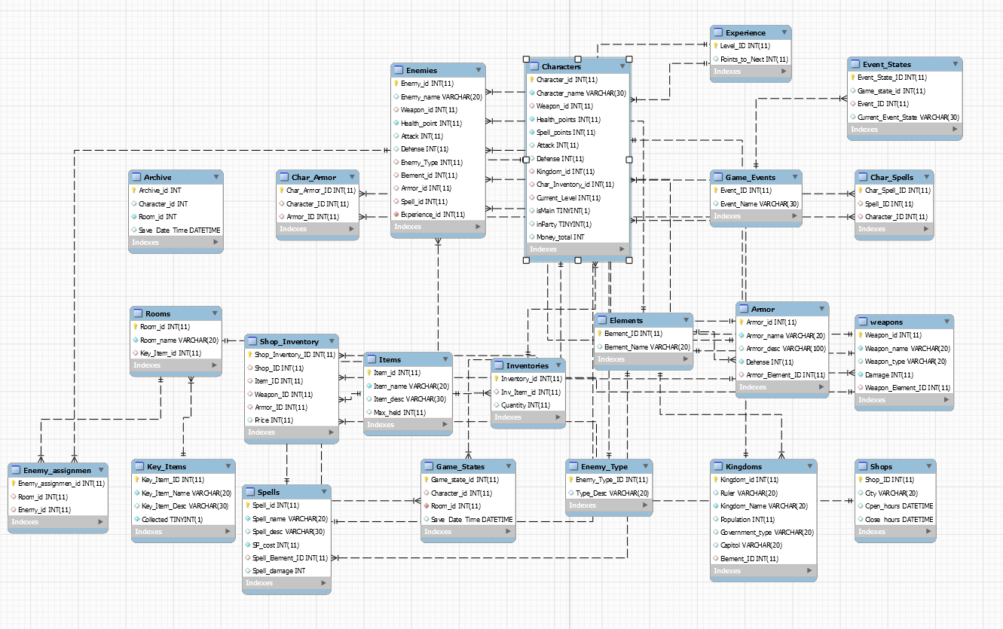
Graphical Schematic
This database is for a hypothetical computer-based role-playing game, with a design based on a fictional world
developed by Correy Winke, Jared Schindler, and Stephanie Wilson.

Slide 4
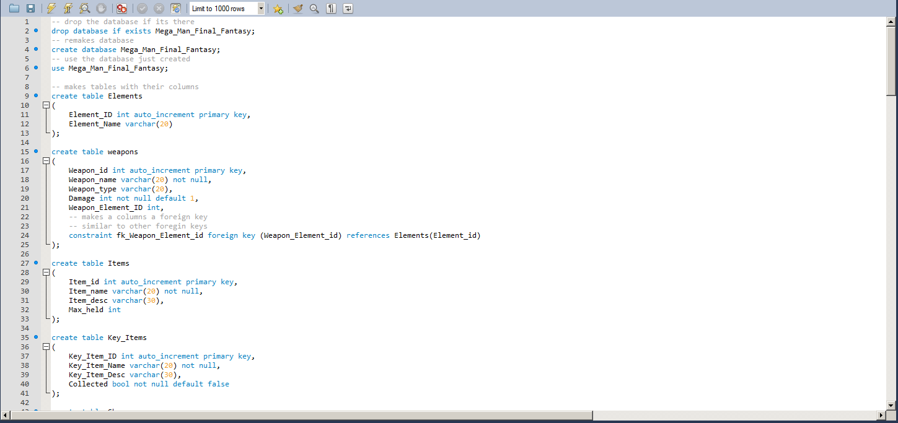
Creation Script
This database is for a hypothetical computer-based role-playing game, with a design based on a fictional world
developed by Correy Winke, Jared Schindler, and Stephanie Wilson.

Slide 5
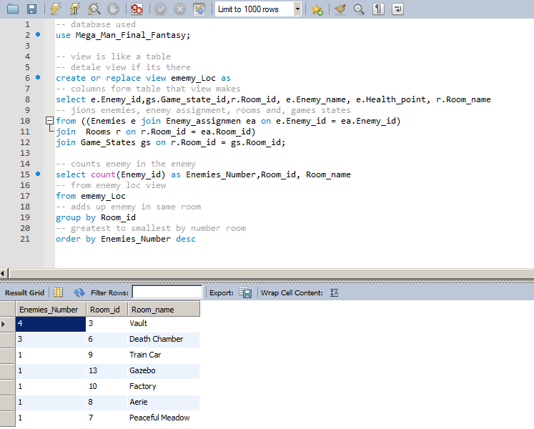
Query
This query is designed to show how many enemies are in the rooms shown in the result grid.

Slide 6
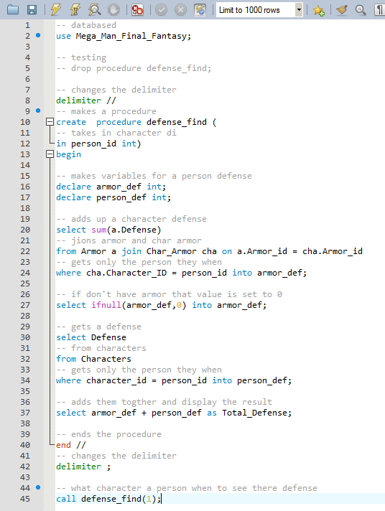
Procedure
This procedure is designed to calculate the total defense for a character, and displays that value in the result grid.

Slide 7
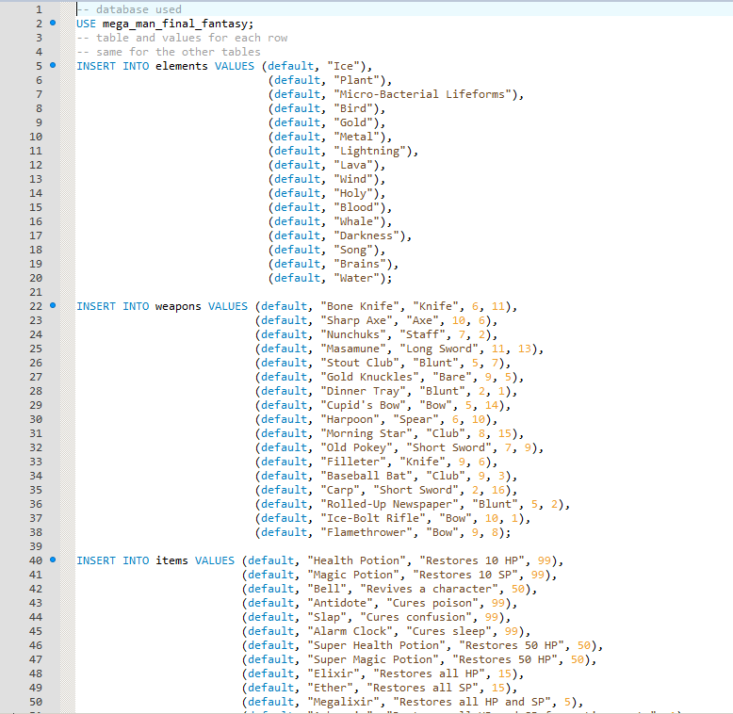
Add Columns
This script adds columns to our rows.

Slide 8
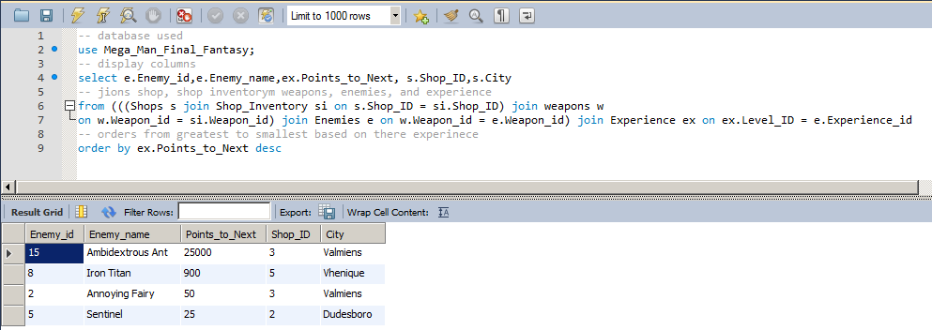
Query
Some of the shops have sold weapons to the player’s enemies. This query shows which enemies have purchased the most deadly weapons, and from which shop.

Slide 9
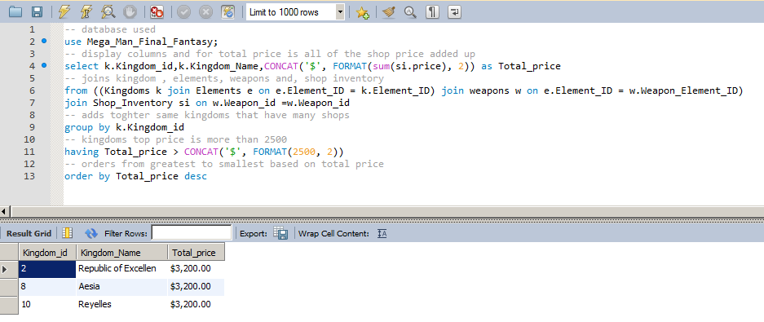
Query
This query displays the total value of all the items of each kingdom’s shop. All of the shops have a value of 3,200 space-dollars.

Slide 10
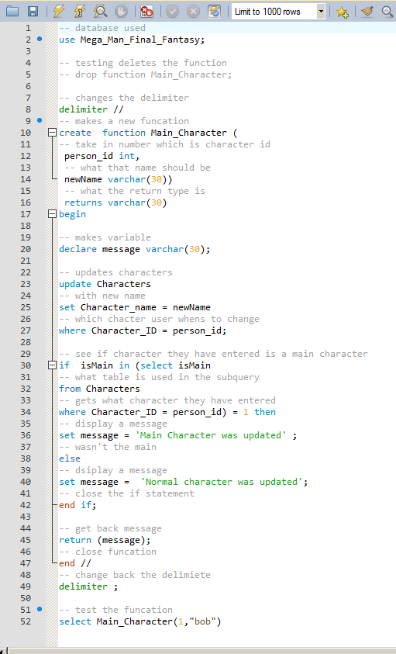
Function
There are many characters in the game, but only one is the main character. This function is designed to show if the character selected is the main character, or a secondary character.

Slide 11
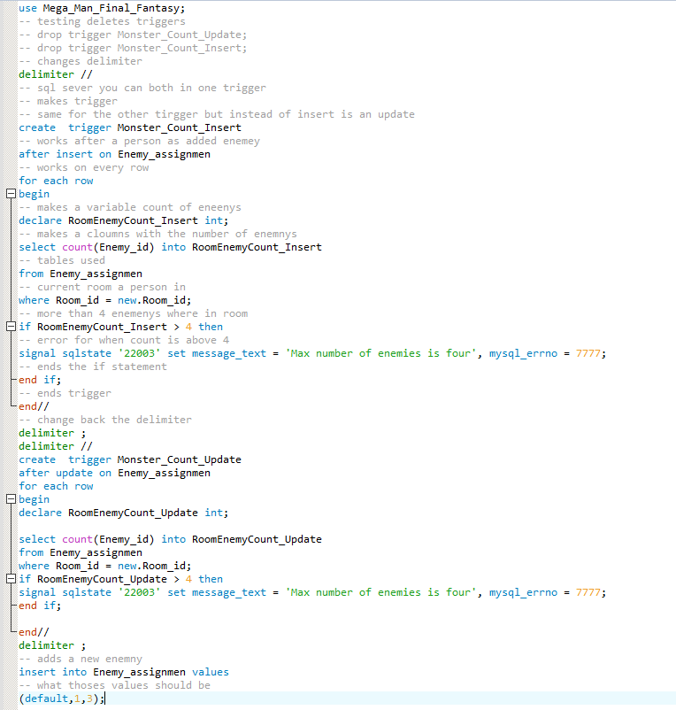
Trigger
This trigger is designed to place a maximum of four (4) into each ‘room’ (or area).

Slide 12
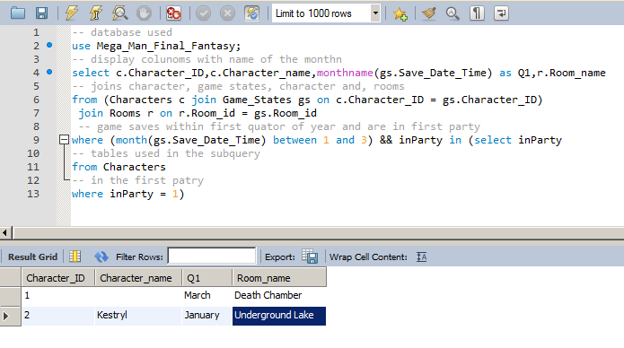
Query
This query displays two different instances of a game being played. In the first game, the main character, in march, has a saved game in the room named ‘Death Chamber’. In the second game, Kestryl, in January, saved in the Underground Lake area. This query only shows games from the first quarter of the year, in a program that would track the time.

Slide 13
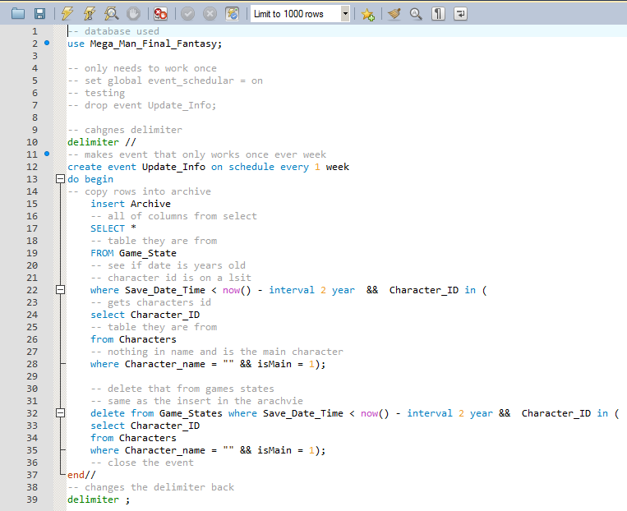

Event
This event will take a game state that has not been modified for 2 years or more, and will remove it from the game state table and into the archive.

Slide 14
Thank you!
Special thanks to spacecat for giving us the strength to carry on through the tough times.

